Slide 1



EASEASSIST
Where dreams and opportunities converge
Team members
Alina Asim 20i-0628
Maryum Zafar 20i-1874
Shayan Khan 19i-0743
Supervisor
Ms. Maheen Arshad

Slide 2

Outline
01
Product overview
02
Timeline
03
Work Progress
04
Challenges
05
Solution
06
To-Dos
07
Coming-Up Next

Slide 3
1
2
3
4
5
Obstacles in Finding the Relevant Scholarship
Navigational Challenges in Scholarship Journey
Timely Tracking Woes and missed deadlines
Inefficient Application Review
Manual Scheduling and Time Conflicts
PROBLEMS
Notes:
Obstacles in Finding the Relevant Scholarship

Slide 4




PRODUCT OVERVIEW
EaseAssist is your comprehensive solution to the complexities of scholarship. With EaseAssist, you'll find all your scholarship and university needs in one place. This includes effective tracking tools to monitor your applications, valuable alumni insights, and timely deadline notifications. Plus, our automated shortlisting and scheduling features make your university application process smoother than ever.

Slide 5
Features for Students
2
Document Management and Verification
1
User-Friendly Application Portal
5
Real-time Application tracking
4
Personalized Recommendation Engine
3
Mentors Guidelines

Slide 6
Features for Universities
2
Automated shortlisting
4
Scholarships Analytics
1
User-Friendly Application Portal
3
Conflict free meeting scheduling

Slide 7




Timeline for FYP
Sep-Oct
Nov-Dec
Jan-Feb
Mar-April
Scheduling Algorithm
Integration
Deployment
Student registration
Doc-Wallet backend
Data Gathering/Generation
Web Scraping
Doc-wallet
User profile Creation
Recommendation model training
University Profile creation
Shortlisting Model Training/Testing
Network Creation
SEP-CT
Notes:
Obstacles in Finding the Relevant Scholarship

Slide 8







Our Work Progress
Iteration 2 (October 2023- December-2023)
1.
2.
3.
4.
User Profile
Doc-wallet
Web scraping
Recommendation model
Notes:
Obstacles in Finding the Relevant Scholarship

Slide 9









Iteration 2 (October 2023- December-2023)
Tools and Technologies

Slide 10
Features we Implemented
1.
2.
3.
4.
User Profile
Doc-wallet
Web scraping
Recommendation model
Notes:
Obstacles in Finding the Relevant Scholarship

Slide 11
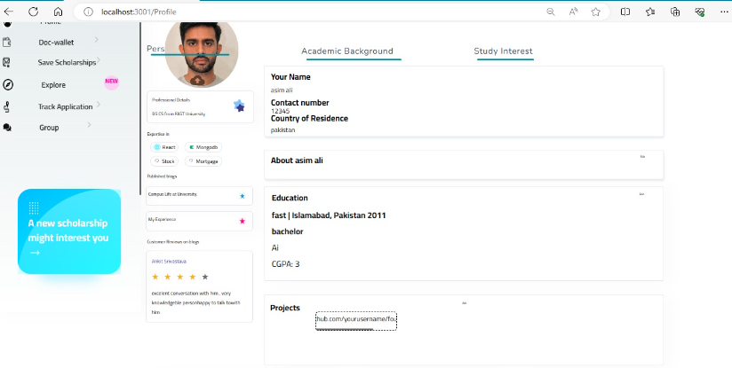
Profile
1.
User Profile
Notes:
Obstacles in Finding the Relevant Scholarship

Slide 12
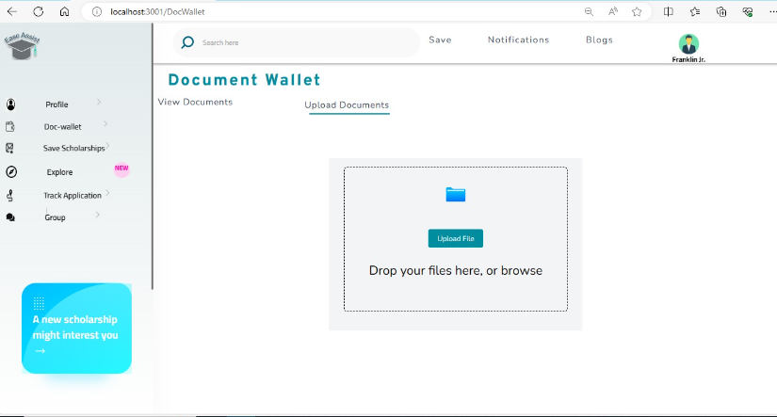
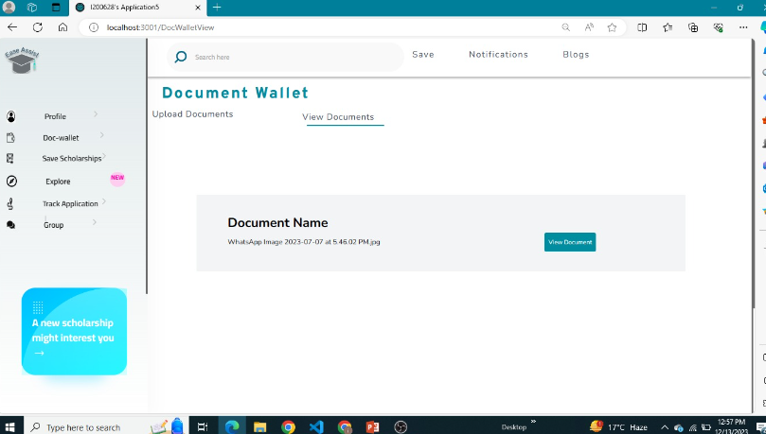
DocWallet
2.
Doc-wallet
Notes:
Obstacles in Finding the Relevant Scholarship

Slide 13
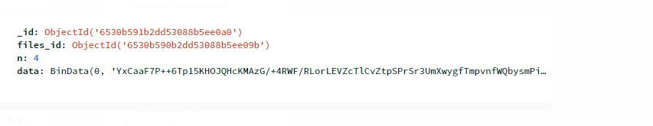
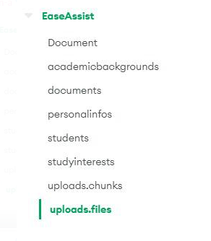
CHALLENGES
1. How we are going to extract documents from database as they are stored in chunks and bytes?

Slide 14


SOLUTION
Using AWS Storage Service.
AWS S3 Bucket

Slide 15
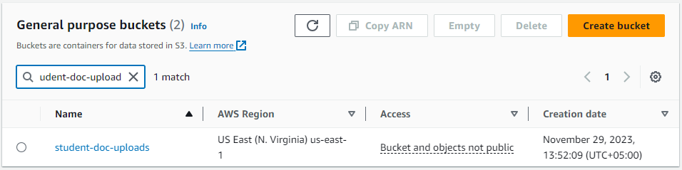
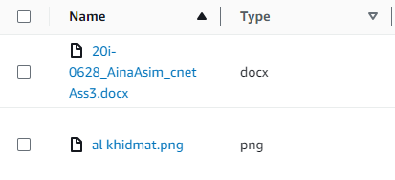
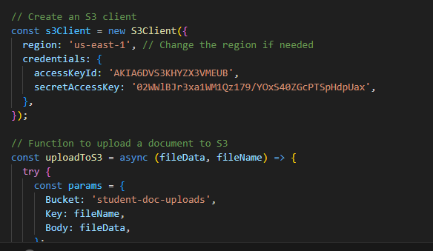

AWS S3

Slide 16
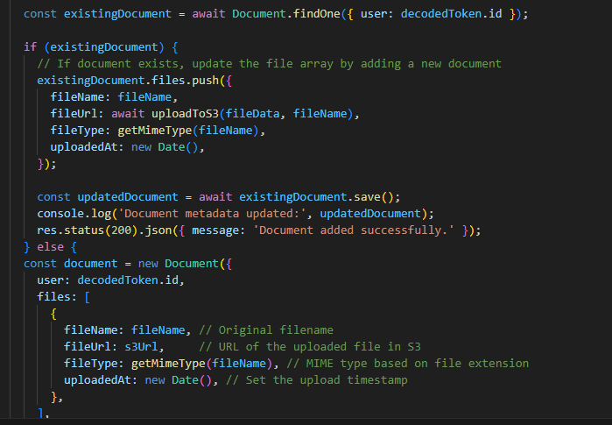
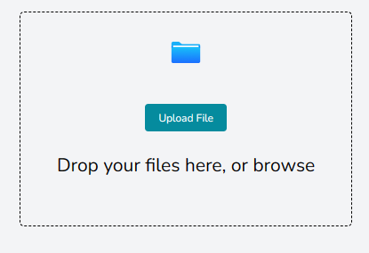
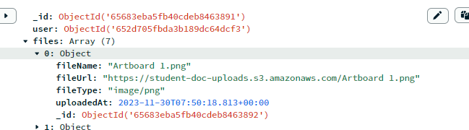
Links Storing in DB

Slide 17
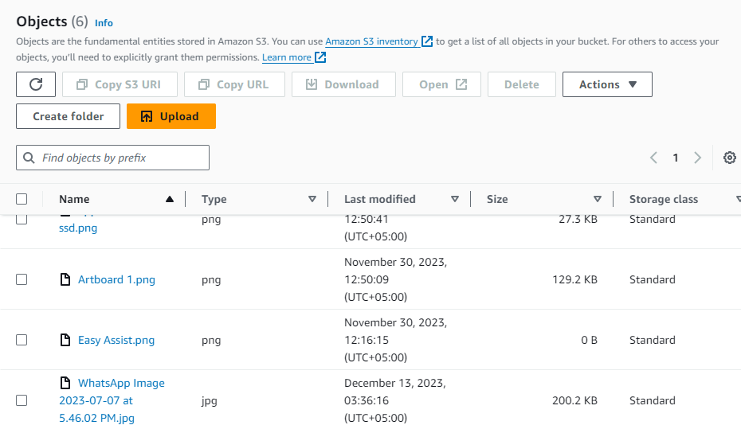
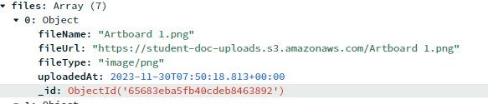
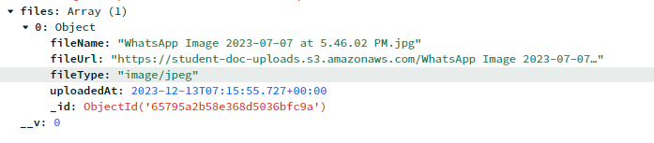
URL in DB

Slide 18
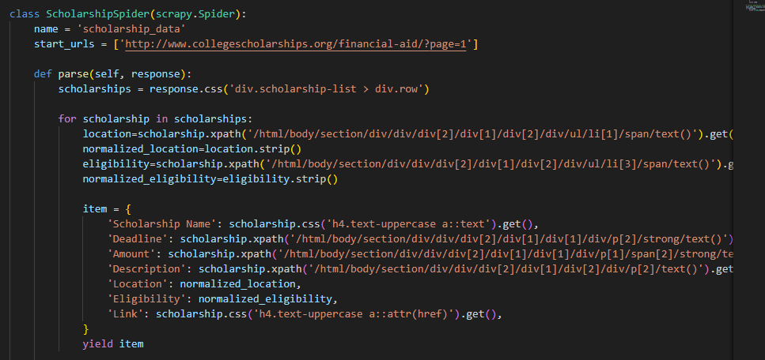
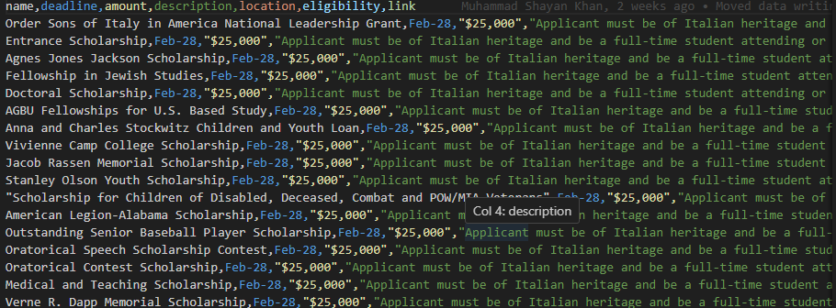
Web Scraping
3.
Web scraping
Notes:
Obstacles in Finding the Relevant Scholarship

Slide 19
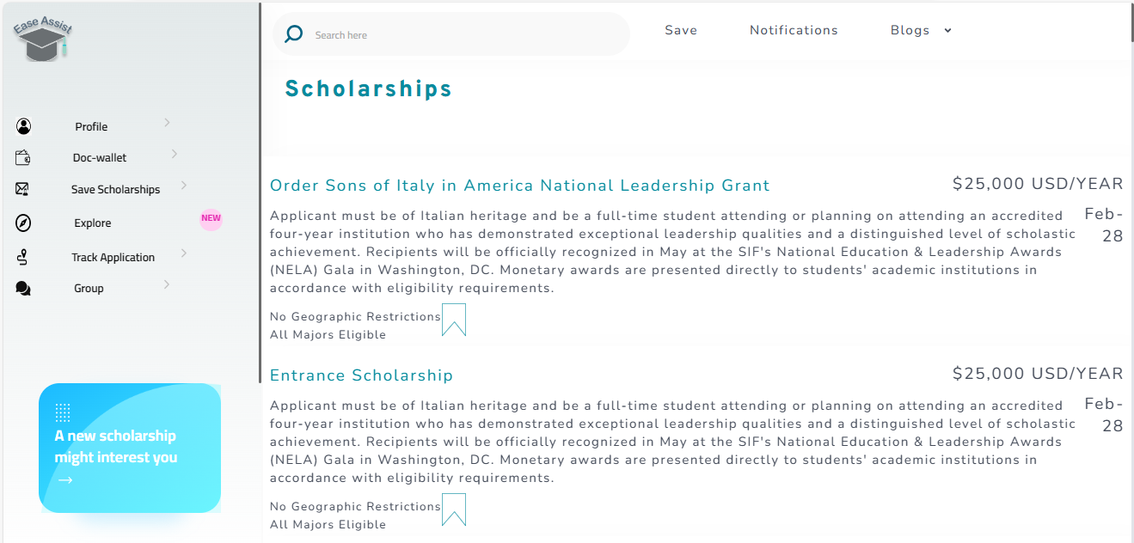
SCRAPED SCHOLARSHIPS

Slide 20
CHALLENGES
2. How we are going to save thousands of scraped scholarships in database?

Slide 21
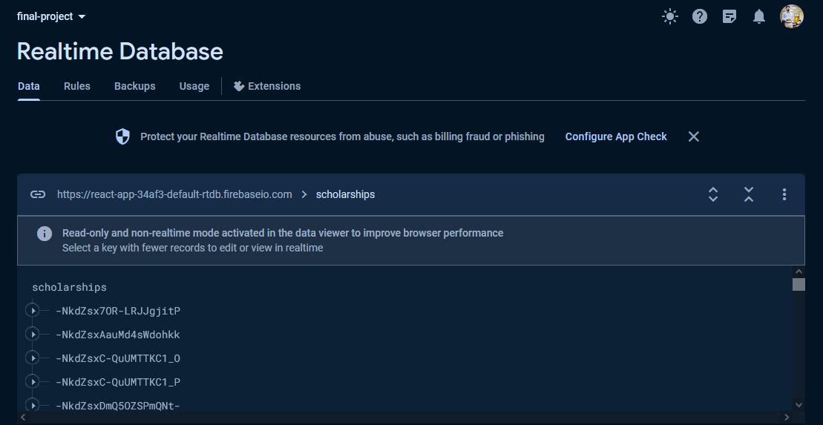
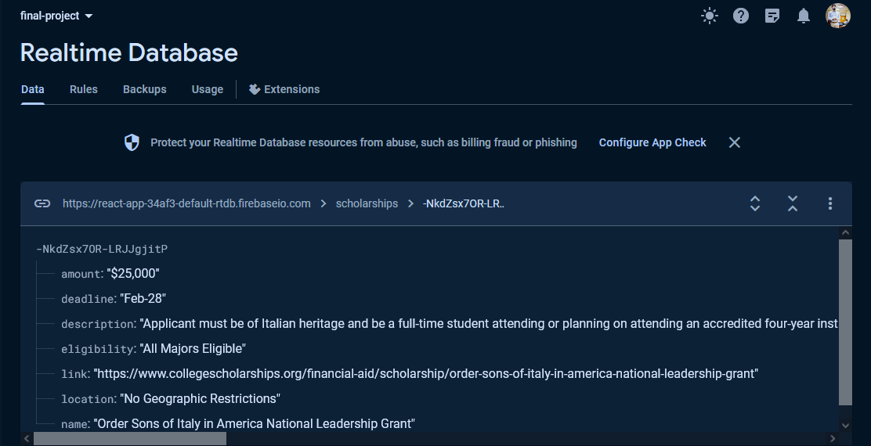
SOLUTION
Data in Firebase:

Slide 22
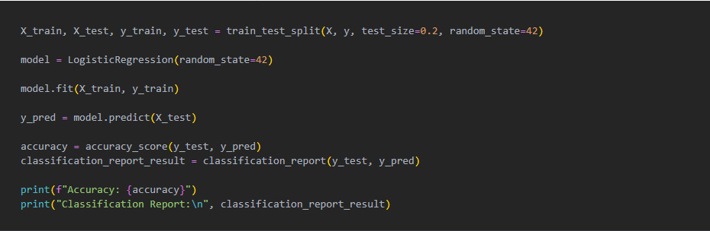
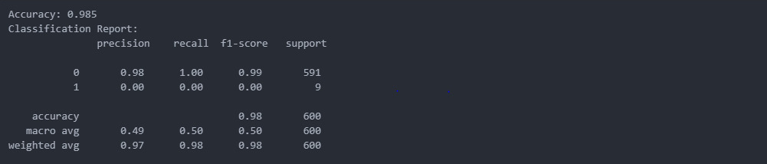
4.
RECOMMENDATION MODEL

Slide 23
DEMO VIDEO

Slide 24

THANK YOU

